Slide 1
Introduction to Object-Oriented Programming
By Abeeha Sattar

Slide 2
Small Intro to Java Execution Pipeline
Edit – Create/edit the source code
Compile – Compile the source code
Load – Load the compiled code
Verify – Check against security restrictions
Execute – Execute the compiled

Slide 3
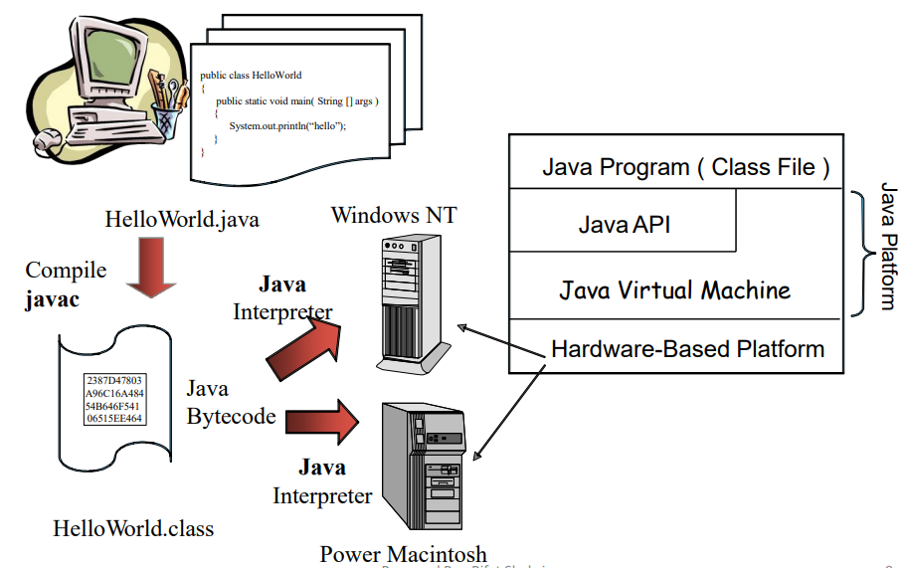
Java Platform

Slide 4
Bytecode
  They are not machine language binary code
  They are independent of any particular microprocessor or hardware platform
  They are platform‐independent instructions
  Another entity (interpreter) is required to convert the bytecodes into machine codes that the underlying microprocessor understands
  This is the job of the JVM (Java Virtual Machine)

Slide 5
JVM (Java Virtual Machine)
  It is a part of the JDK and the foundation of the Java platform
  It can be installed separately or with JDK
  A virtual machine (VM) is a software application that simulates a computer, but hides the underlying operating system and hardware from the programs that interact with the VM
  It is the JVM that makes Java a portable language

Slide 6
JVM (Java Virtual Machine)
  The same bytecodes can be executed on any platform containing a compatible JVM
  The JVM is invoked by the java command – java Welcome
  It searches the class Welcome in the current directory and executes the main method of class Welcome
  It issues an error if it cannot find the class Welcome or if class Welcome does not contain a method called main with proper signature

Slide 7
JIT Compiler
  When a JIT compiler is part of the JVM, selected portions of bytecode are compiled into executable code in real time, on a piece-by-piece, demand basis.
  An entire Java program is not compiled into executable code all at once, in this case.
  Not all sequences of bytecode are compiled—only those that will benefit from compilation.
  The remaining code is simply interpreted.

Slide 8
Some Useful Commands
  Use javac <filename>.java to compile a java file using the command prompt
  Use java <classname> to execute the class file that was generated by the javac command.

Slide 9
Class Diagrams
&
Basic Syntax for Classes

Slide 10
Class Diagrams
Class name (or identifier): identifies the class.
Data Members or Variables (or attributes, states, fields): contains the
attributes of the class.
Member Functions (or methods, behaviors, operations): contains the
dynamic operations of the class.
Class Name
Data Members
Member Functions

Slide 11


Examples of Classes
Person
-Name : String
-Age : int
Class Name
Data Members
+Walk(): void
+Talk(): void
+Eat(): void
Member Functions
Pokemon
Type : String[]
Height : float
Weight : float
+Attack(): void
+Dodge(): void

Slide 12
Examples of Objects
Emily : Person
Dragonite : Pokemon
Name = “Emily”
Age = 29
Type = {“dragon”, “flying”}
Height = 2.2
Weight = 210
Walk()
Talk()
Eat()
Attack()
Dodge()

Slide 13
Let’s map the class diagram to code now!
class Person {
private String Name;
private int Age;
public void Walk() {//walk}
public void Talk() {//talk}
public void Eat() {//eat}
};
Person
-Name : String
-Age : int
+Walk() : void
+Talk() : void
+Eat() : void

Slide 14
Let’s map the class diagram to code now!
???
Pokemon
- Type : string[]
- Height : float
- Weight : float
+Attack(): void
+Dodge(): void

Slide 15
Creating an object of a class:
public static void main(String[] args) {
Person Emily;
Pokemon Dragonite;
}
But we can’t access any of the variables we made : (
How do we fix that?

Slide 16
Access Modifiers | Access Specifiers
One of the main features of object-oriented programming languages is data hiding.
Data hiding refers to restricting access to class members.
Data hiding also becomes important when we are trying to encapsulate our data!

Slide 17
Types of Access Specifiers:
Specifier | Same Package (non-subclass) | Same Package (subclass) | Other Package (subclass) | Other Package (non-subclass)
Private | No | No | No | No
Protected | Yes | Yes | Yes | No
Public | Yes | Yes | Yes | Yes
Default (when you don’t write anything with the variables/functions) | Yes | Yes | Yes | No

Slide 18
The “public” Access Modifier
Fields marked as public can be accessed by anyone
Public members are accessible from any part of the program
Syntax:
class MyClass { // The class
public int member; // Access specifier - class members go here,
// after the specifier
};

Slide 19
The “private” Access Modifier
Fields marked as private can only be accessed by functions that are a part of that class
They are not allowed to be accessed directly by any object or function outside the class

Slide 20


The “protected” Access Modifier
The protected members can be accessed by the derived/child classes.
The protected members can be accessed by everything within the same package as the class as well.
We’ll look more into protected members when practicing inheritance.
For now, that is all you need to know!

Slide 21

Let’s have a look…
public static void main(String[] args) {
Person Emily = new Person();
Emily.name = “Emily”;
Emily.age = 29;
Emily.Walk();
Emily.Talk();
Emily.Eat();
}
So how will we ever edit these fields?

Slide 22
Accessor & Mutator Functions
Widely referred to as getters and setters.
Set functions are also sometimes called mutators (because they mutate, or change, values)
Get functions are also sometimes called accessors (because they access, or retreive values).
They help us solve the problem of private fields being inaccessible in the main function.

Slide 23
Getters | Setters
A class’s private data members can be manipulated only by member functions of that Class.
These member function names need not begin with set or get, but this naming convention is common, and highly advised.
Providing public set and get functions allows clients of a class to access the hidden data, but only indirectly

Slide 24
Going back to our Person class…
Class Person {
private String Name;
private int Age;
//setters and getters
public void setName(String name) {
Name = name;
}
public String getName() {
return Name;
}
public void setAge(int age) {
Age = age;
}
public int getAge() {
return Age;
}
void Walk() {//walk}
void Talk() {//talk}
void Eat() {//eat}
};
Setters
Getters

Slide 25
Updating Main
public static void main(String[] args) {
Person Emily = new Person();
Emily.setName(“Emily”);
Emily.setAge(29);
Emily.Walk();
Emily.Talk();
Emily.Eat();
System.out.println(Emily.getName() + " " + Emily.getAge());
}
Using the setters that we made to set the values of name and age
Using the getters that we made to get the values of name and age, and print them using cout

Slide 26
Encapsulation
One of the principles of OOP
Encapsulation is a process of wrapping of data and methods in a single unit.
The main advantage of using of encapsulation is to secure the data from other methods, when we make a data private then these data only use within the class, but these data not accessible outside the class.

Slide 27
Encapsulation
In Java, encapsulation is used along with the classes and the access specifier concept.
Encapsulation is the process of combining data and function into a single unit called class.
You can say it as a protective wrapper that stops random access of code defined outside that wrapper.

Slide 28
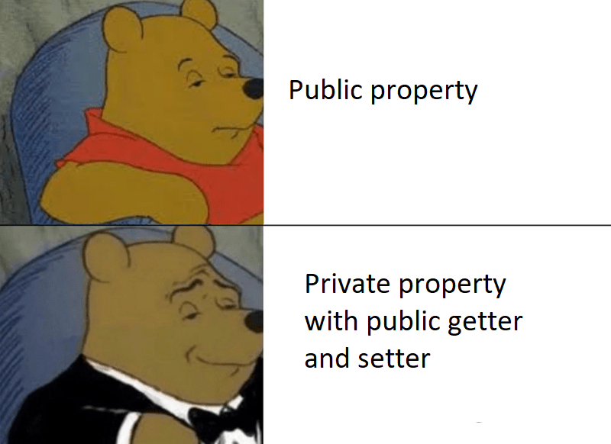

Slide 29
Encapsulation
Think of the class as a capsule the holds together the medicine
In this case, methods and variables are the medication
And the class is the capsule itself!
variables
methods

Slide 30
Why do we want to Encapsulate Data?
Simplicity | Clarity
Better understanding of the code
Lowers code complexity
Manage/Limit data access

Slide 31
Abstraction
A way to selectively show only the relevant details of an object
Principle of abstraction:
“Capture only those details about an object that are
relevant to current perspective”

Slide 32
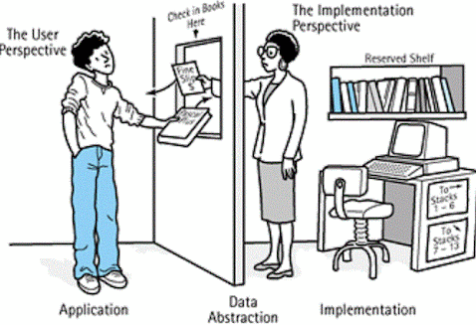
Abstraction
Perspective: A point of view
The person only knows there is a book window for
borrowing and returning books, he doesn't care or
doesn't need to know about how the book is found
and what happens before and after he requests or
return a book
Let’s identify the things that are relevant to the
  Borrower - ???
  Librarian - ???

Slide 33
Abstraction – Advantages
Simplifies the model by hiding irrelevant details
Abstraction provides the freedom to defer implementation decisions by avoiding commitment to details

Slide 34
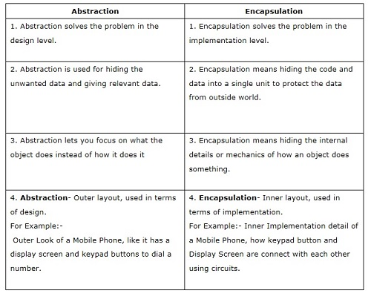
Abstraction v/s Encapsulation

Slide 35
Class Task
Class Elevator
private: currentFloor, minFloor, maxFloor
setter ensures floor is within bounds
getter to display which floor it is on
function moveUp(), moveDown()

Slide 36
Class Task
Class User
private: username, password
setter for password must:
  length ≥ 8
  contain at least one digit
getter for password should NOT return actual password, only "******"

Slide 37
Class Task
Class Quiz
private: questions[10], correctAnswers[10]
setter to add questions
function checkAnswer(qNo, userAnswer)
function score()
Main asks questions and user input answers
Answers passed to checkAnswer as argument.

Slide 38
Fin.
O-o

